Slide 1

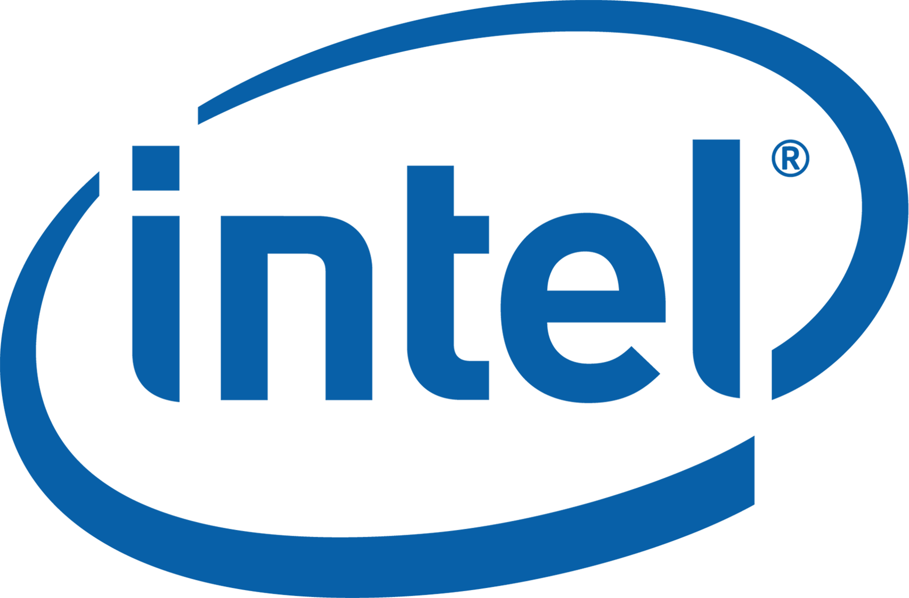
Modernize with SQL Server 2019 and Intel® Technologies
Presenting Sponsors:
Notes:
Use this slide as the title slide > if the title is very long, use the second option

Slide 2
SQL Server 2008 EOS Is Coming - Modernizing with Intel® Technologies
Notes:
[Moderator Part]
The moderator’s script will be added in this section after deck submission.

Slide 3


Carlos Lopez
Experience
Microsoft Certified Professional 2012/2014, 2016-2017
Over 10 years of experience
Multi-platform DBA
Community
Guatemala SQL Server User Group – board member
Senior DBA, ATOS
/carlos-lopez-taks
Fields of Experience
@CarlosLopezDBA
MS SQL Server
Linux Distros
Oracle 10-11g
carlosarturo.lopeztaks
caltls@gmail.com
Notes:
[Moderator Part]
This 24 Hours of PASS session is presented by Carlos Robles. Carlos originally from Guatemala living in US now for the past 3 years has over 10 years experience in the database administration field.
He considers himself a multi platform DBA due to his experience on multiple platforms such as Unix, Windows, Linux, Azure and different database engines like MySQL, Oracle, SQL Server and Azure SQL DB
Don’t forget to check his blog where you can find SQL Server tips, best practices, scripts and more.
[move to next slide]
scripts and more.

Slide 4
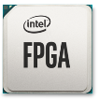
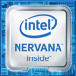


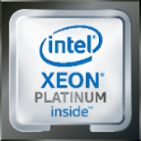




Data-Centric Infrastructure Focus
MOVE Faster
MOVE More
PROCESS Everything
ethernet
Silicon Photonics
Omni-Path fabric
Software & System-Level OPTIMIZED
Notes:
At Intel, we have been investing in silicon innovation for years to drive the right technology foundation to move, store and process data across the data centric compute landscape
This has included ongoing investment in our CPU portfolio, but also includes leading products for data movement such as our Ethernet product offerings, delivering storage innovation and efficiency with Intel Optane DC and QLC 3D NAND SSDs, and creating unique discrete compute acceleration with Stratix 10 FPGAs.
It also means accelerating investment in new spaces including discrete acceleration technologies for AI workloads, disruptive innovation for persistent memory, and networking with our Silicon Photonics products.

Slide 5
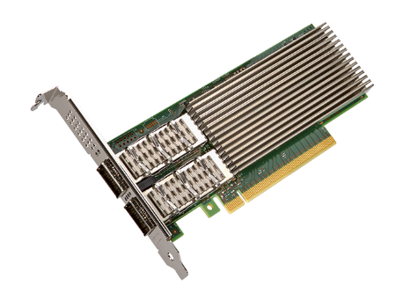
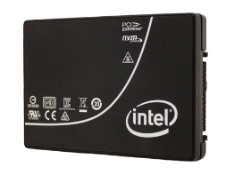
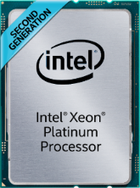
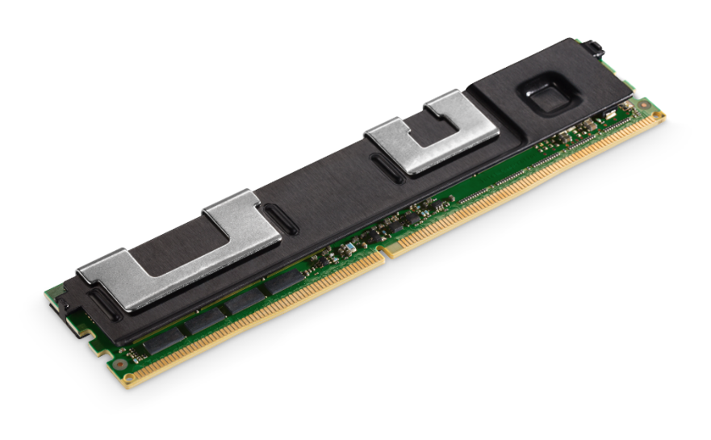
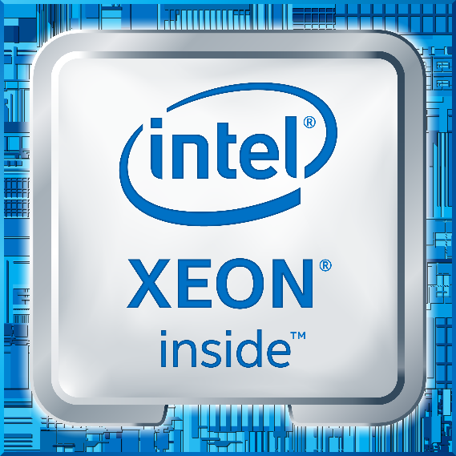
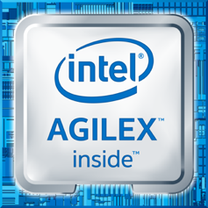
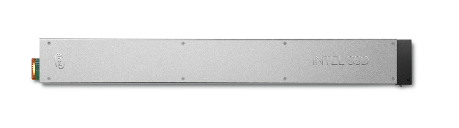
Data-Centric Portfolio
Move Faster
Store More
Process Everything
INTEL®
ETHERNET
800 SERIES
INTEL®
OPTANE™ DC Persistent Memory
DUAL Port
INTEL®
OPTANE™ DC SSD
2nd Generation
INTEL®
Xeon® Scalable
INTEL®
Xeon® D-1600
INTEL®
AGILEX™ FPGA
INTEL®
QLC 3D NAND SSD
Notes:
Today, we expand our portfolio to move, process and store data with the introduction of Intel Ethernet 800 adapters, Intel Optane DC D4800X SSDs, Intel QLC 3D NAND SSD, new Intel Optane DC Persistent Memory Modules, Intel Xeon D 1600 processors, Intel Agilex FPGAs and of course the momentum continues with 2nd Generation Intel Xeon Scalable Processors.
In total representing years of Intel engineering and eco system investment to deliver the foundation of the next generation of data centric innovation.

Slide 6
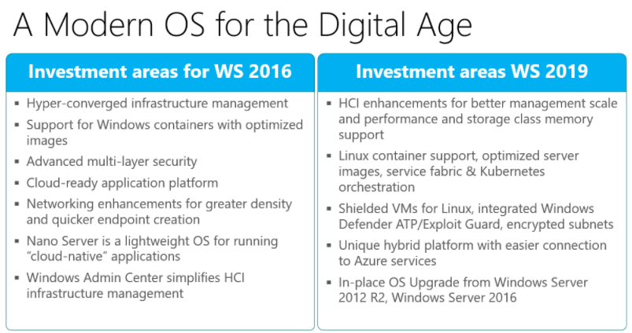

Slide 7
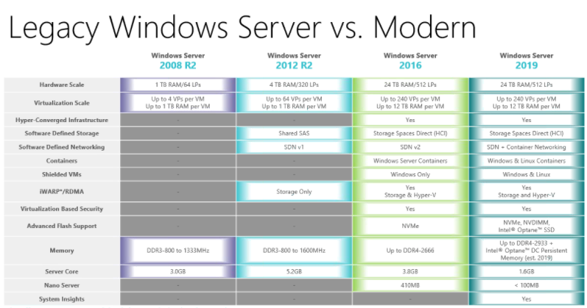

Slide 8
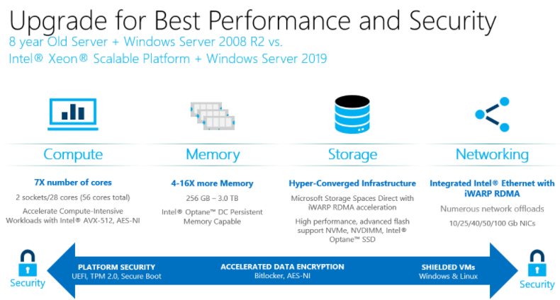

Slide 9

Transforming the Memory Storage Hierarchy
Memory
DRAM
hot tier
Persistent
Memory
Improving
memory capacity
Storage
Improving
SSD PERFORMANCE
SSD
warm tier
Delivering
EFFICIENT STORAGE
Intel® 3D NAND SSD
HDD / TAPE
cold tier
Notes:
The most disruptive capability of the 2nd generation Xeon Scalable processor may be the integrated control of breakthrough memory capacity including Intel Optane DC persistent memory.
Today’s memory and storage hierarchy rely on fast and expensive DRAM coupled with slower but cost effective storage technologies.
While larger memory sizes have been technically feasible, economic limitations have capped affordable memory capacity and limited memory hungry applications, like in-memory compute, big data analytics, high capacity VM environments, and real time fraud detection to process data in real time at the same time lacking persistence.
Intel Optane DC persistent memory addresses this.

Slide 10
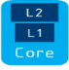
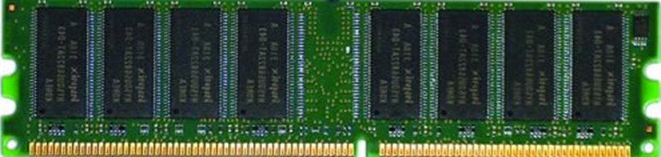

Goal: Efficient Data Centric Architecture
CPU
LLC
Core
L2
L1
pico-secs nano-secs
DRAM
hot tier
Memory Sub-System
10s GB
<100nanosecs
Optimize performance given cost and power budget
100s GB
<1microsec
Access Distribution
Move Data Closer to Compute
Maintain Persistency
Hot data
1s TB
<10microsecs
SSD
warm tier
Cooler data
← more often
less often →
SSD
10s TB
<100microsecs
Data Access Frequency
Intel® 3D Nand SSD
Network
Storage
HDD / TAPE
cold tier
10s TB
<100millisecs
Notes:
A typical data access frequency distribution looks like this….
<click once>
Optimize performance given cost and power budgets…need to MATCH the hot data to the hot tier (hot media types, like DRAM) and the cooler data to the cooler tiers (Cold media types like NAND)….as you see it in the memory/storage pyramid…
<click once>
…and how this looks in the data center architecture itself.
<click once>
Bringing more data closer to compute and adding persistency supports data centric architecture to be more efficient and effective.

Slide 11

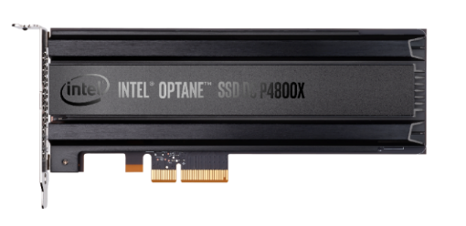
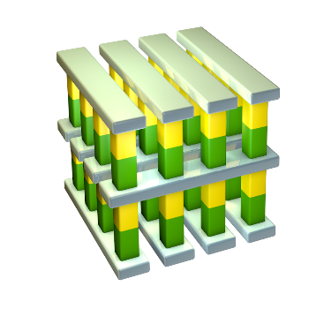

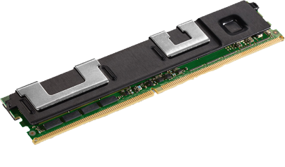
Technology Driven: Intel® Optane™ Technology Unleashing breakthrough performance for a new generation of computing
Intel® 3D XPoint™ Memory Media
Intel® building blocks
Intel® Optane™ Technology
1
2
3
Intel System
Memory Controller,
Interface HW, and SW IP
Breakthrough material advances for scalability & high performance
Notes:
The INTEL advantage where media and controller are designed by INTEL. As well as HW and Software IP. The building blocks of 3DXPoint+INTEL= Optane technology

Slide 12
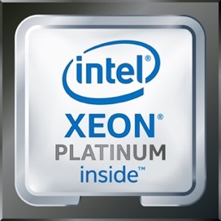
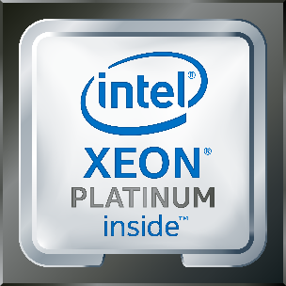
Faster Query Performance with 2nd Gen Intel® Xeon® Processor + SQL Server
Faster Data Warehouse Query Performance with latest sw & hw
Queries/hr.
Past Customer Experience
33,681 queries per hour at 1TB scale factor with a 4 year old system
Customer Experience Today
With 2nd Gen Intel® Xeon® Scalable processors:
836,261 queries per hour at 1TB scale factor
24.8X better
Performance results are based on testing by Intel as of 2/8/2019 and may not reflect all publicly available security updates. See configuration disclosures for details. No product or component can be absolutely secure.
Software and workloads used in performance tests may have been optimized for performance only on Intel microprocessors. Performance tests, such as SYSmark and MobileMark, are measured using specific computer systems, components, software, operations and functions. Any change to any of those factors may cause the results to vary. You should consult other information and performance tests to assist you in fully evaluating your contemplated purchases, including the performance of that product when combined with other products. For more complete information visit www.intel.com/benchmarks. 1. Configuration: See slide 13
*Other names and brands may be claimed as the property of others
Notes:
2 different swimlanes. Past Experience vs New
Data Warehouse Demo on a 4yr old server running SQL Server 2008 vs SQL Server 2017 on a Xeon Scalable Platform.
On the 4yr old system we are coming at ~34k queries / hr.
On the latest platform that jumps to 835k queries/hr. 24.8x better
This jump is attributed to new SW and HW.
You can consolidate servers as you migrate from old HW to new HW.

Slide 13
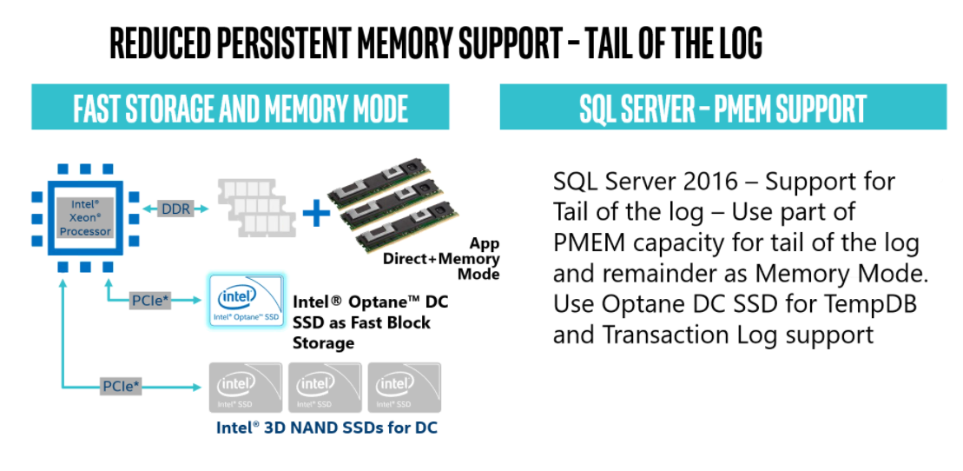

Slide 14
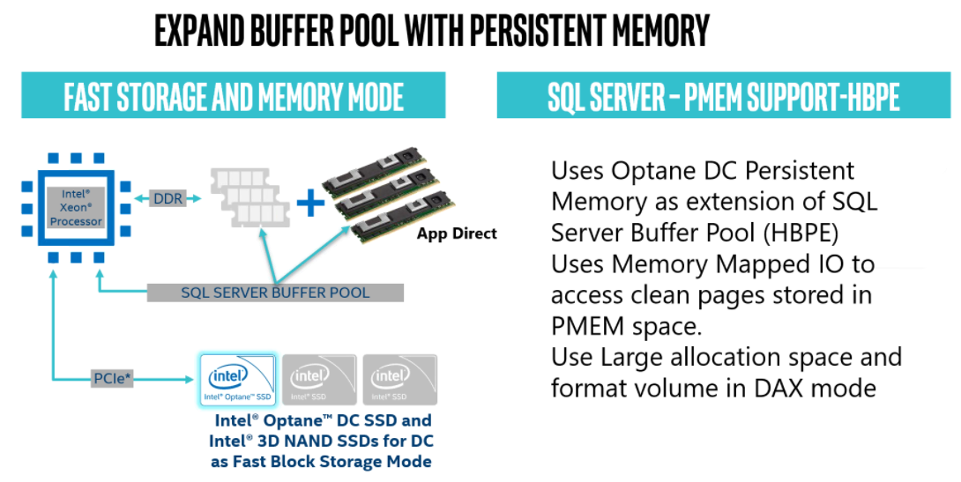

Slide 15
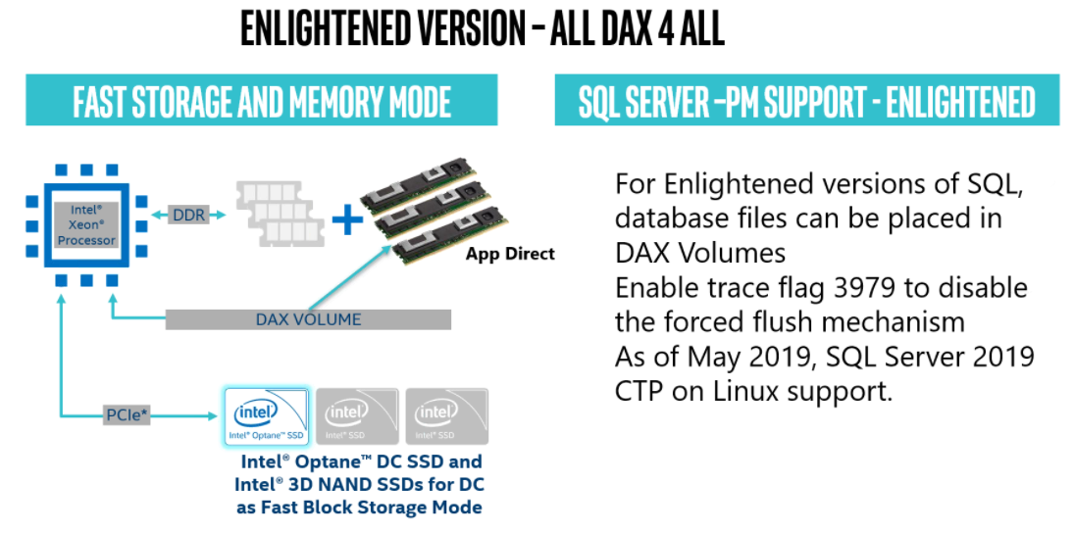

Slide 16
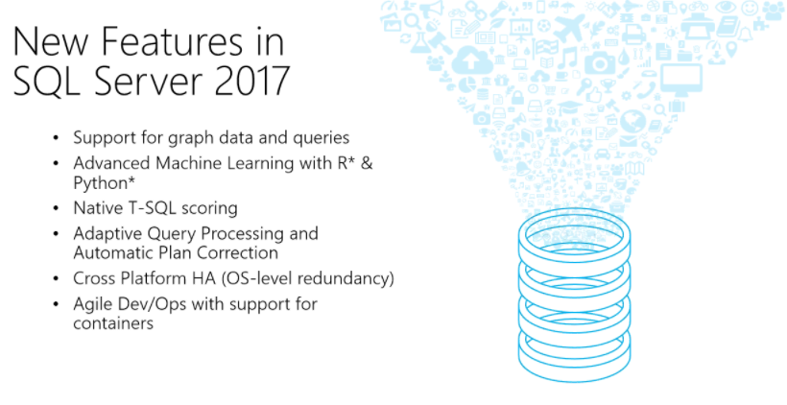

Slide 17

Memory Mode Example- Virtualized SQL Server
Increase VMs per node for multi-tenant virtualized Databases
ALL DRAM Configuration (768 GB)
22 Microsoft SQL VM instances with DRAM memory at ~$1,588 USD per VM
30 Microsoft SQL VM instances at ~$1,108 USD per VM
DRAM (192 GB) + Intel® Optane™ DC Persistent Memory (1024 GB)
36% more VMs per node¹
30% lower estimated HW cost per VM²
Performance results are based on testing by Intel as of 3/13/2019 and may not reflect all publicly available security updates. See configuration disclosures for details. No product or component can be absolutely secure. Software and workloads used in performance tests may have been optimized for performance only on Intel microprocessors. Performance tests, such as SYSmark and MobileMark, are measured using specific computer systems, components, software, operations and functions. Any change to any of those factors may cause the results to vary. You should consult other information and performance tests to assist you in fully evaluating your contemplated purchases, including the performance of that product when combined with other products. For more complete information visit www.intel.com/benchmarks.
¹⁻² Configuration: See Notices & Disclaimers
Notes:
This is a dBaaS scenario. Comparison between DRAM and Intel Persistent Memory.
In the all DRAM system we were able to run about 22 SQL VMs.
In the second scenario we see a jump to 30 SQL VMs.
That’s 36% jump in vm’s per node and 30% lower TCO per VM.

Slide 18

Intel® Select Solutions
with pre-defined and verified
infrastructure solution stacks
available from a
range of partners
BOOST
IT Velocity
>50
Verified Partner Solutions
with highly optimized configurations
of industry-leading
intel data center technologies
INCREASE
System Level Performance
to accelerate your
pace of innovation across
critical business workloads
UNPARALLELED
HW / SW Ecosystem
http://www.intel.com/selectsolutions
Notes:
Intel Select Solutions – Intels campaign to deliver optimized and pre-validated solutions to customers.
Workload optimization, configurations using the right Intel technology foundation delivering pre-verified performance, and room for system differentiation with solution provider enhancements, Select Solutions provide customers a path to accelerate data centric deployments.
There are currently over 50 verified partner solutions in market today.

Slide 19
Making workload acceleration Easy With Intel® Select Solutions
Analytics
Hybrid Cloud
Microsoft SQL Server Windows Server
Microsoft Azure Stack
UPDATED
Microsoft Azure Stack HCI
UPDATED
Microsoft SQL Server Linux*
UPDATED
* Coming Soon
iNTEL.COM/SELECTSOLUTIONS
Notes:
Here are the major Intel Select Solutions that Intel partnered with Microsoft. Intel launched Select solutions for SQL Server both on Win Server & Linux and are currently updating to the latest generation of Xeon Technology.

Slide 20
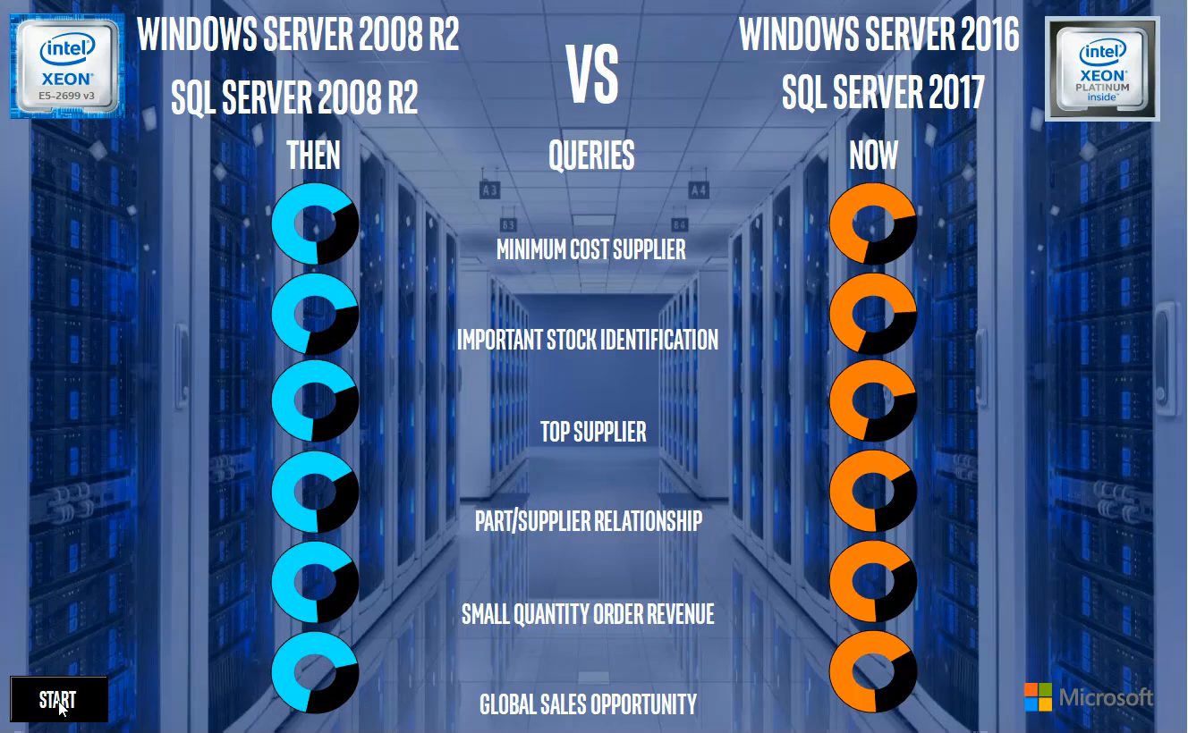


Reduced Query Runtimes⁴
With 2nd Gen Intel® Xeon® Scalable Processor + SQL Server 2017
Performance results are based on testing by Intel as of 3/13/2019 and may not reflect all publicly available security updates. See configuration disclosures for details. No product or component can be absolutely secure. Software and workloads used in performance tests may have been optimized for performance only on Intel microprocessors. Performance tests, such as SYSmark and MobileMark, are measured using specific computer systems, components, software, operations and functions. Any change to any of those factors may cause the results to vary. You should consult other information and performance tests to assist you in fully evaluating your contemplated purchases, including the performance of that product when combined with other products. For more complete information visit www.intel.com/benchmarks.
⁴ Configuration: See Notices & Disclaimers
Notes:
The demos shows how fast some of the most common queries run on a system build with Win Server 2016 and SQL Server 2017 and 2nd Gen Intel Xeon Scalable Processor.

Slide 21
Thank You

